Slide 1
THE TOXICITY DATASET
Presented by - Agaba & Jonah
Affiliation: Makerere University
Uganda
Authors:
1. Agaba Lucky
2. Kyagaba Jonah

Slide 2
CIRCADIAN RHYTHM
Circadian rhythm refers to the natural, internal process that regulates the sleep-wake cycle and other physiological processes in living organisms over a roughly 24-hour period. These rhythms are driven by an internal biological clock, primarily located in the suprachiasmatic nucleus (SCN) of the brain, which responds to environmental cues such as light and temperature.
Dataset type Classification
The dataset includes 171 molecules designed for functional domains of a core clock protein, CRY1, responsible for generating circadian rhythm. 56 of the molecules are toxic and the rest are non-toxic.
The data consists a complete set of 1203 molecular descriptors and needs feature selection before classification since some of the features are redundant.
We used Recursive Feature Elimination together with Decision Tree Classifier (DTC) to get the best set of molecular descriptors for DTC.

Slide 3
Research Questions
How does the toxicity of small molecules affect their ability to regulate the circadian rhythm?
What is the class distribution of toxic versus non-toxic molecules?
Which molecular descriptors are most correlated with the toxicity of the molecules?
Are there any significant outliers in the molecular descriptor data?
How can we visualize and understand the distribution of the molecular descriptors?

Slide 4
Data Wrangling Handling Missing Values
The dataset contained no missing values. Each column had complete data for all 171 entries, making it unnecessary to impute or drop data based on missing values. Handling Outliers To identify outliers, the **Interquartile Range (IQR)** method was used.
This method detects data points that are significantly higher or lower than the majority of the data. Several molecular descriptors showed the presence of outliers, and these were explored through box plots.
Outliers were prevalent in descriptors such as `EE_Dt`, `C2SP2`, and `AATSC7p`, among others.
Outliers were detected using the IQR method across the numerical columns. Box plots were generated to visually inspect the distribution of these features and identify outliers.
For example: - The descriptor `EE_Dt` had several high outliers, suggesting that a few molecules deviate significantly in this measurement.
- Similarly, `C2SP2` and `AATSC7p` displayed outliers that fell outside the typical range, which might influence further analysis.

Slide 5
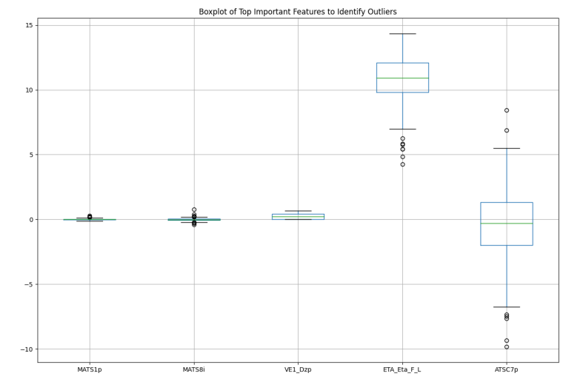

Slide 6
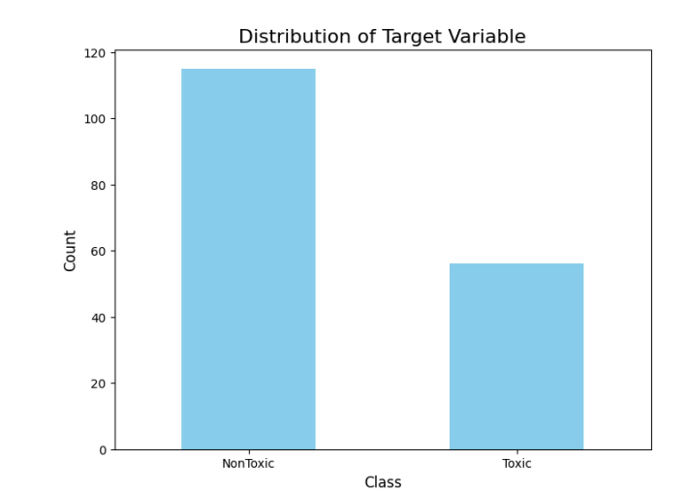
Class Distribution Analysis
Class Distribution Analysis One of the first steps in EDA was to examine the class distribution of the "Class" column, which indicates the toxicity of the molecules.
The analysis showed a class imbalance:
- 115 instances of "NonToxic"
- 56 instances of "Toxic"
This imbalance may influence modeling techniques in the future, as the dataset leans toward non-toxic molecules

Slide 7
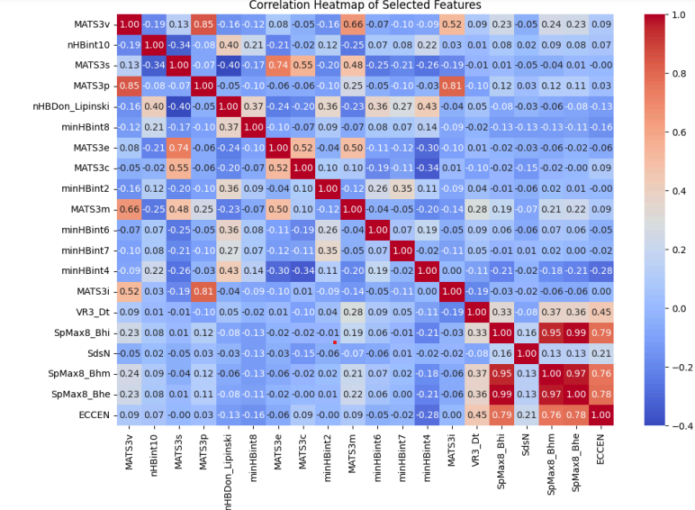
Correlation Analysis
A correlation analysis was performed to identify the molecular descriptors that were most closely related to the toxicity (as measured by the "Class" column). The top 10 molecular descriptors most correlated with toxicity are as follows:
1. EE_Dt (0.214)
2. C2SP2 (0.189)
3. AATSC7p (0.165)
4. SpDiam_Dt (0.165)
5. MLogP (0.164)
6. MATS7p (0.164)
7. nAcid (0.160)
8. nwHBa(0.157)
9. GATS7v (0.156)

Slide 8
CONCLUSION ON EDA
The EDA process yielded several important findings:
- There is a clear class imbalance in the dataset, with far more non-toxic molecules than toxic ones. - Certain molecular descriptors, such as `EE_Dt` and `C2SP2`, are moderately correlated with toxicity, which may guide future modeling efforts.
- Outliers are present in several molecular descriptors, and they may need to be addressed before any modeling process to avoid skewing results.
- The dataset is imbalanced, with more non-toxic molecules, which will
need to be accounted for in any predictive modeling.
- The correlation analysis identified features that are potentially important
for predicting toxicity, and these should be further investigated.

Slide 9
MACHINE LEARNING
Data Splitting: The data was split into training (80%) and test (20%) sets
Class Balancing (SMOTE): Synthetic Minority Over-sampling Technique (SMOTE) is applied to balance classes in the training set, addressing potential issues with class imbalance, which can affect model performance.
Feature Scaling: Feature scaling was performed using StandardScaler, which is particularly useful for distance-based models like SVM and K-Nearest Neighbors (KNN) and models sensitive to feature magnitudes.
Four models are defined for testing:
Logistic Regression
Random Forest
Support Vector Classifier (SVC)
K-Nearest Neighbors (KNN)

Slide 10
MACHINE LEARNING
Training and Evaluation: Each model was trained on the scaled, balanced training set and evaluated on the scaled test set. The following metrics are reported for each model:
Accuracy: The percentage of correct predictions on the test set.
Classification Report: Includes precision, recall, and F1-score per class.
Confusion Matrix: Visualizes the count of true positives, true negatives, false positives, and false negatives, providing insight into the model’s prediction distribution.
Scales;
0 - Non Toxic
1-Toxic

Slide 11
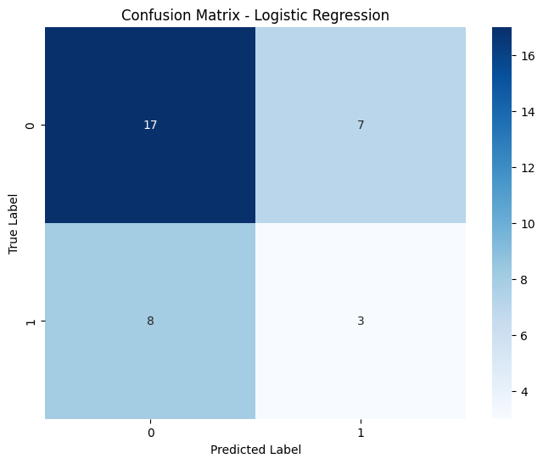
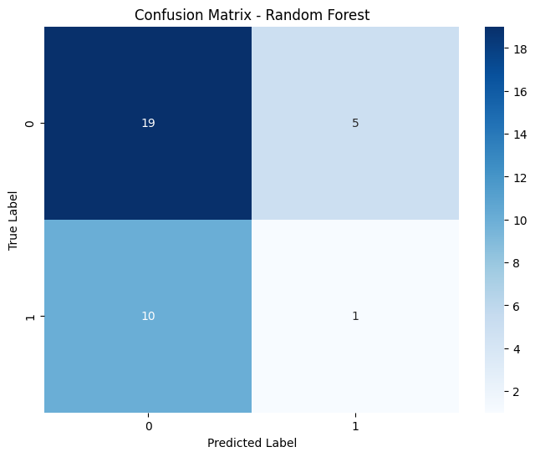
Logistic Regression
Random forest
Precision | 0.68
Recall | 0.71
F1 Score | 0.69
Precision | 0.66
Recall | 0.71
F1 Score | 0.79

Slide 12
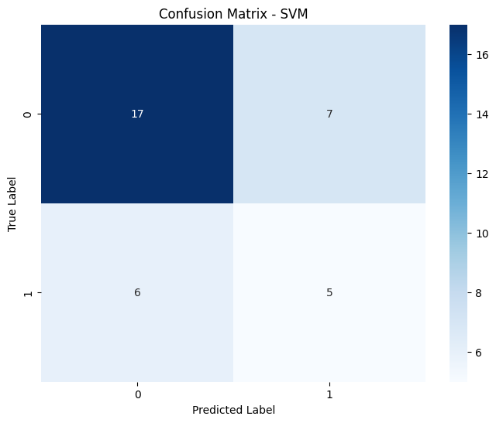
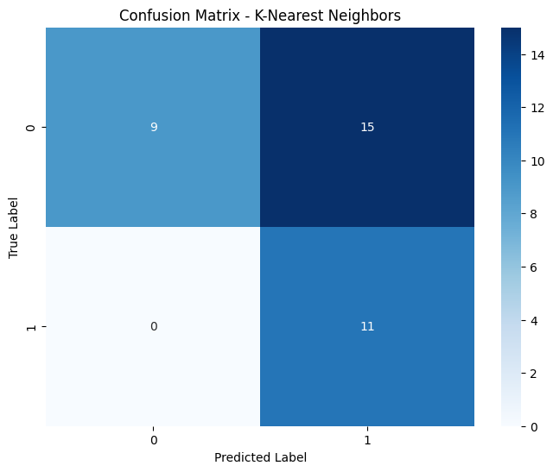
Support Vector Machine
KNN ALGORITHM
Precision | 0.74
Recall | 0.71
F1 Score | 0.72
Precision | 1.00
Recall | 0.38
F1 Score | 0.55

Slide 13
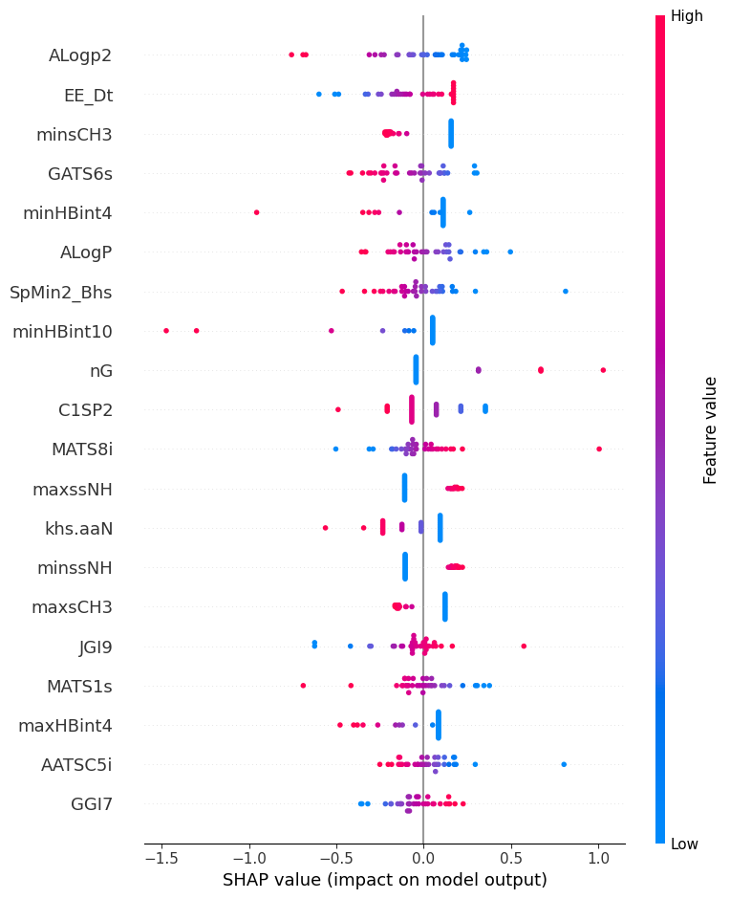
SHAP EXPLAINABILITY FOR FEATURE IMPORTANCE SVM

Slide 14
Micro Gas Turbine Electrical Energy Prediction
In the context of rising energy demands and a global push towards sustainable and decentralized power systems, micro gas turbines (MGTs) have emerged as a viable solution. MGTs are small-scale, high-efficiency power generation units that can operate on various fuels, including natural gas and biogas. They are increasingly deployed in microgrids and hybrid energy systems to provide reliable power, often complementing renewable sources like solar and wind. However, accurately predicting the electrical energy output of MGTs remains a challenge due to the complex interplay of factors affecting their performance, such as environmental conditions, fuel characteristics, and machine parameters. Machine learning (ML) offers powerful tools for modeling and prediction in this domain, enabling real-time adjustments that optimize efficiency, enhance reliability, and support grid stability. This study focuses on applying machine learning to predict MGT electrical energy output, with the goal of improving efficiency, minimizing operational costs, and ensuring consistent power delivery.

Slide 15
Dataset type: Regression
The dataset contains 52,940 entries with three columns: The three columns include;
time: A continuous variable representing time in seconds.
input_voltage: A continuous variable representing the input voltage (float).
el_power: A continuous variable representing electrical power output.
Research Questions
How does input voltage relate to electric power consumption?
What are the trends and patterns in electric power usage over time?
Is there an optimal input voltage range that minimizes electric power usage?
Can we forecast electric power demand based on historical data?
Does the variability in input voltage impact electric power stability?
Are there specific time intervals associated with higher or lower input voltage?

Slide 16
Data Wrangling Handling Missing Values
The dataset contained no missing values. Each column had complete data for all 52,940 entries, making it unnecessary to impute or drop data based on missing values.
Handling Outliers;
There were no outliers detected in this dataset for either input_voltage or el_power based on the interquartile range (IQR) method. All values fall within the calculated bounds:
Input Voltage: No values are outside the range of -3.63 to 14.05.
Electric Power: No values are outside the range of -584.77 to 4189.93.
The data is well-contained within typical ranges for both variables.

Slide 17
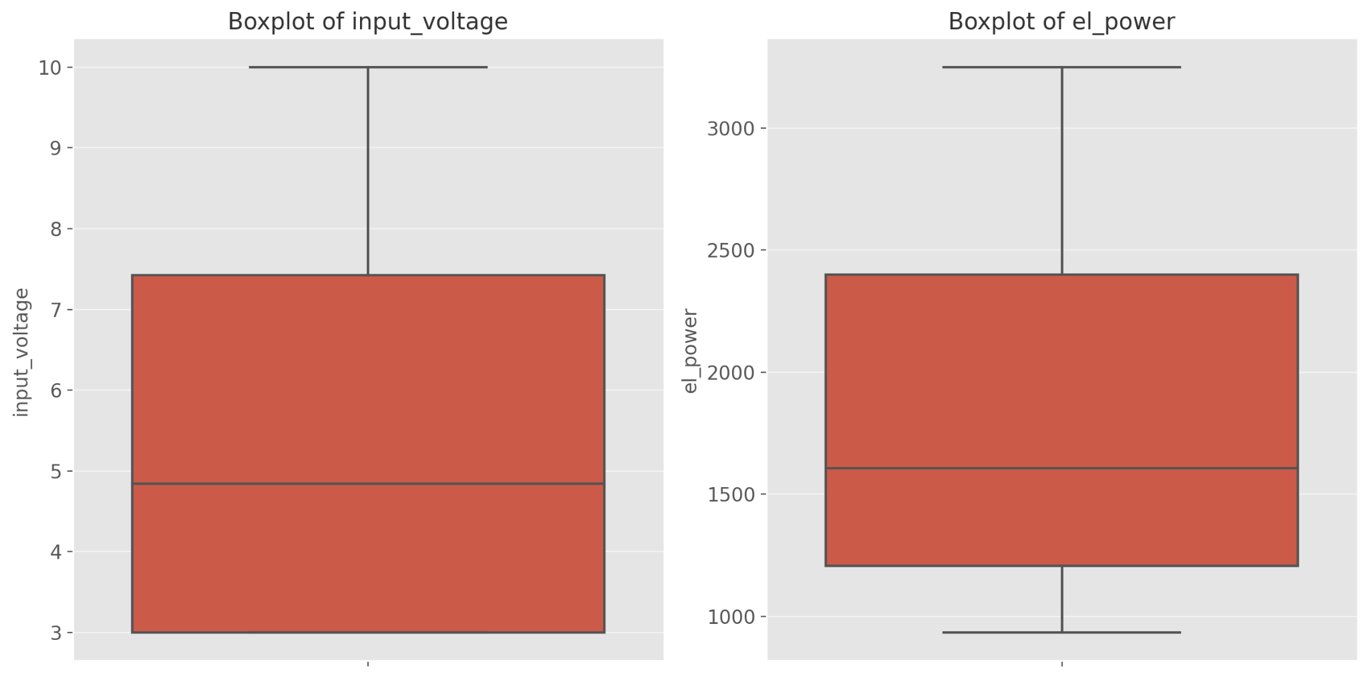
The boxplots for input_voltage and el_power visually confirm that there are no apparent outliers, as all data points fall within the typical range for each feature.

Slide 18
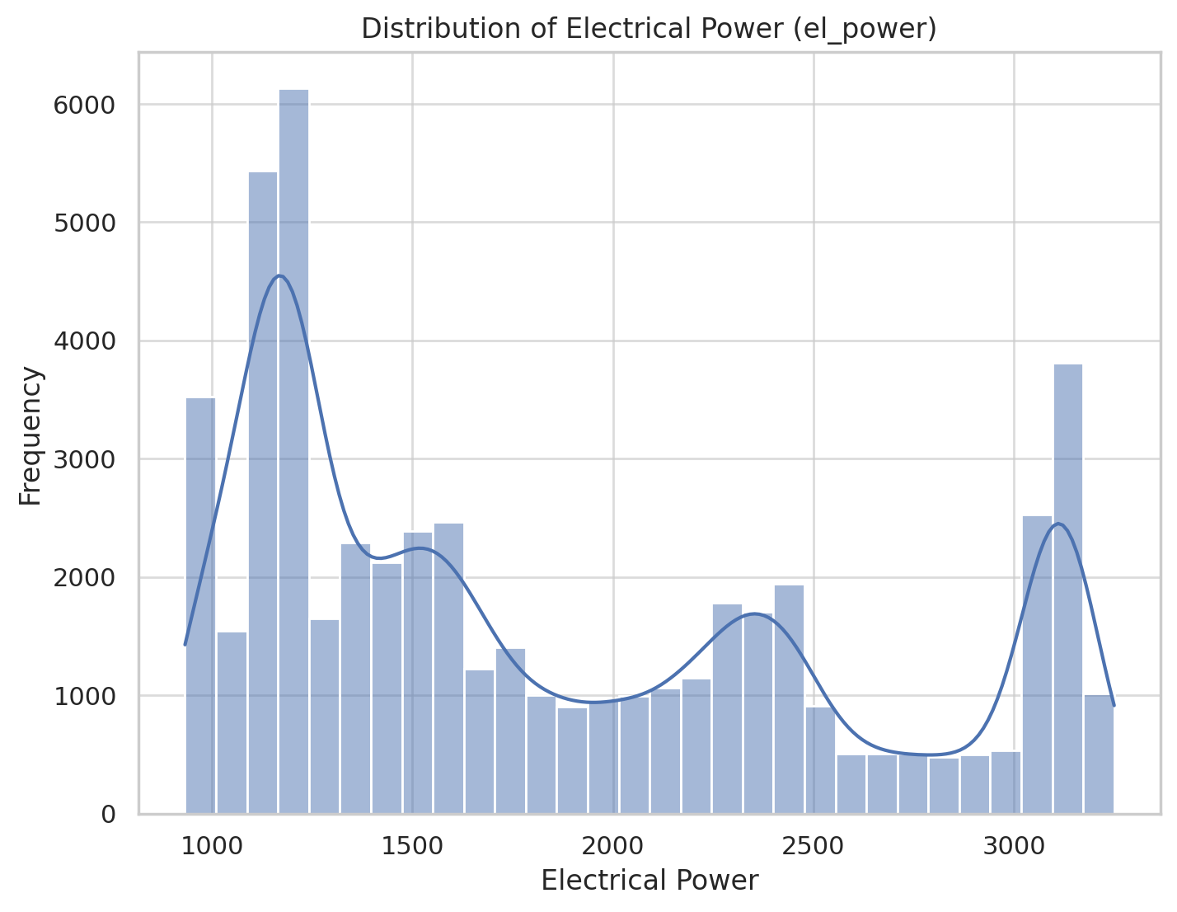
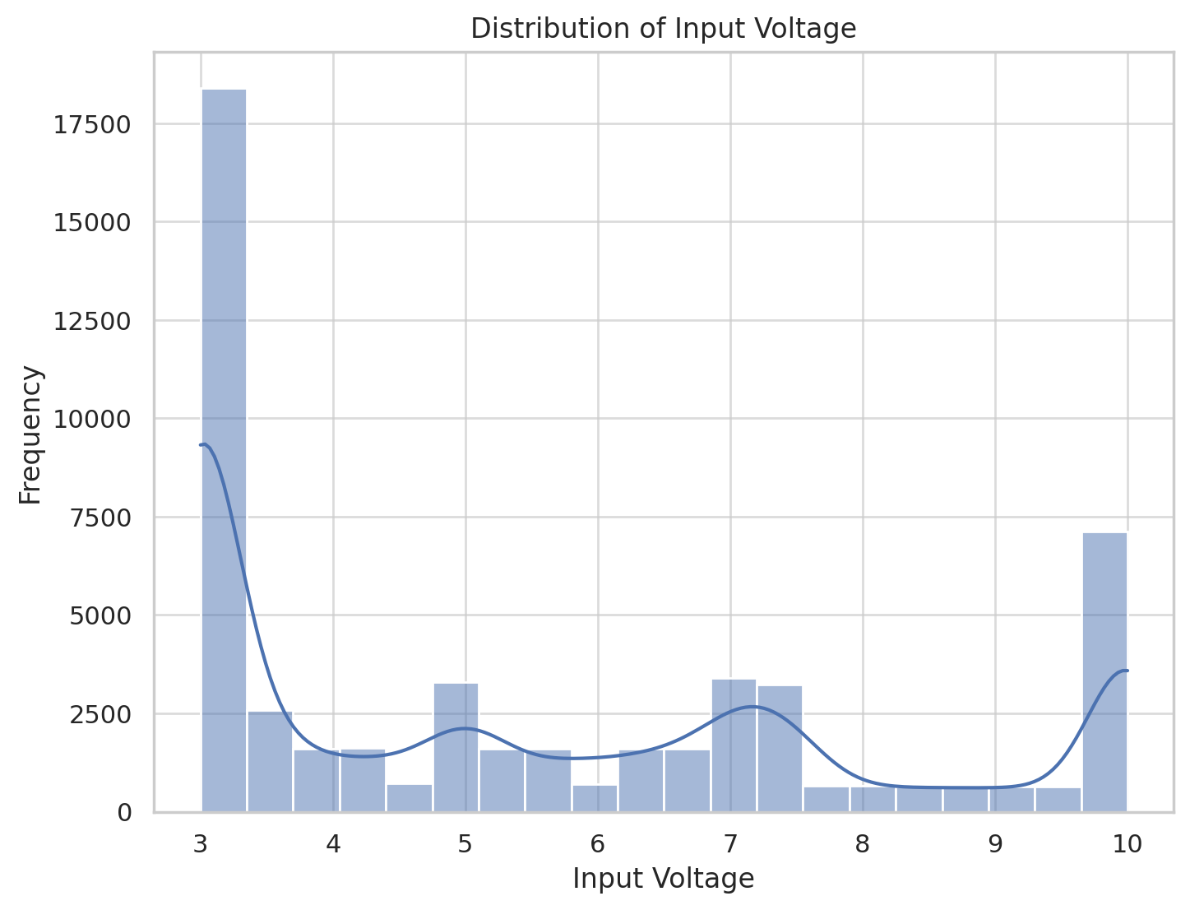
Distribution Analysis
Distribution of Input Voltage: The input voltage appears to be roughly bimodal, with peaks around 3 and 10. This suggests that the voltage may alternate between certain levels or there may be specific conditions leading to different operating ranges.
Distribution of Electrical Power: The electrical power (el_power) has a right-skewed distribution, indicating a concentration of values at the lower end, with fewer instances of high-power readings.

Slide 19
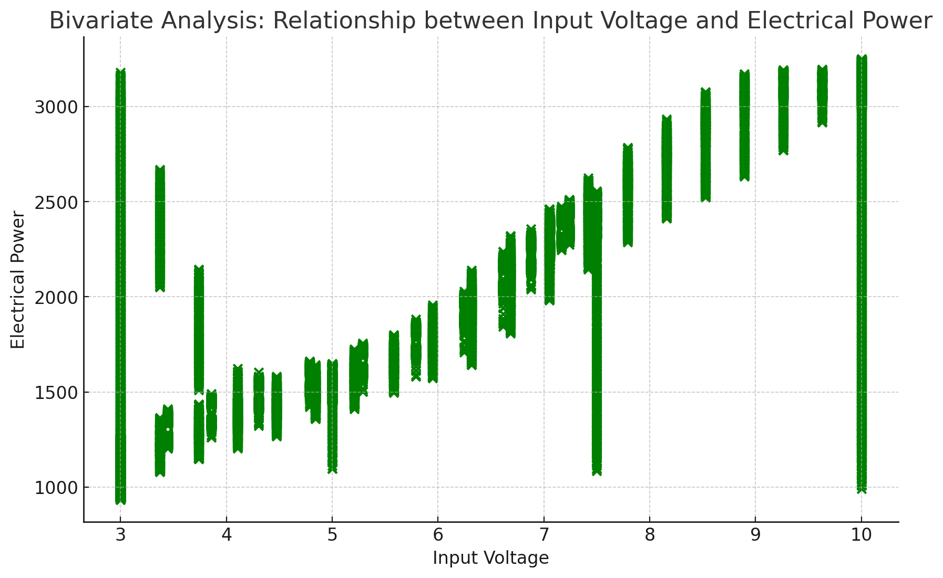
Relationship between Input Voltage and Electrical Power: The scatter plot reveals a strong positive relationship between input_voltage and el_power.
Correlation Coefficient: The correlation coefficient between input_voltage and el_power is approximately 0.88, indicating a strong positive linear relationship.
These analyses suggest that as input voltage increases, electrical power also tends to increase.

Slide 20
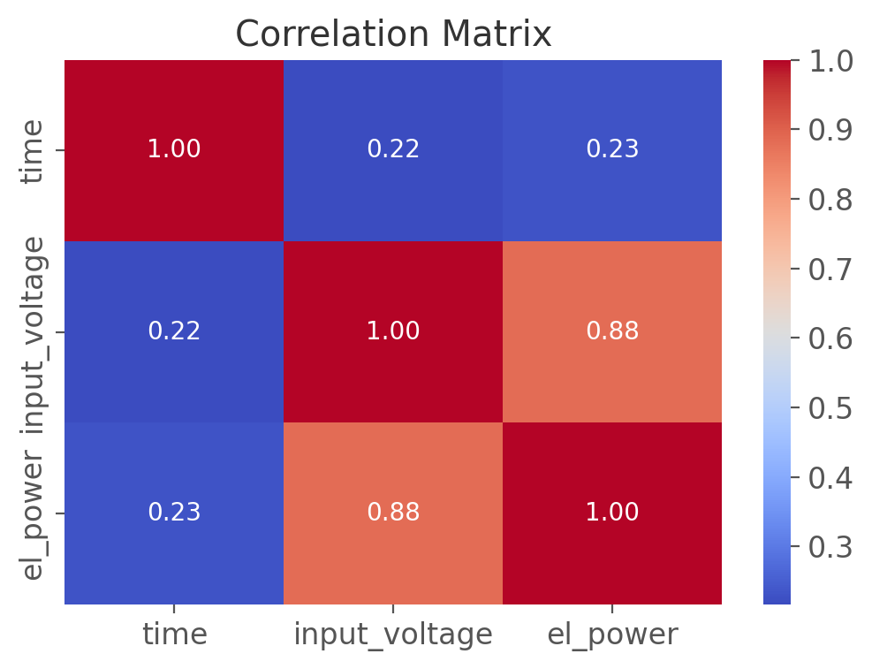
Correlation Analysis
The correlation matrix provides the correlation coefficients between variables. There is a strong positive correlation between input_voltage and el_power. This suggests a close linear relationship between these two variables.

Slide 21
CONCLUSION ON EDA
The EDA process yielded several important findings:
There were no missing values
There were no outliers
The input voltage appears to be roughly bimodal, with peaks around 3 and 10. This suggests that the voltage may alternate between certain levels or there may be specific conditions leading to different operating ranges.
The electrical power (el_power) has a right-skewed distribution, indicating a concentration of values at the lower end, with fewer instances of high-power readings.
The correlation analysis shows a strong positive correlation between input_voltage and el_power.

Slide 22
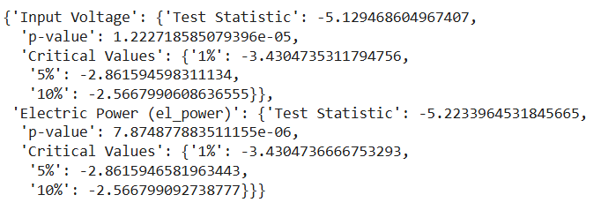
MACHINE LEARNING
Before training the models, we had to check for stationarity.
Input Voltage: If the p-value is below 0.05 and the test statistic is lower than the critical values, we conclude that input_voltage is stationary. This means it does not require further transformation for stationarity.
Electric Power (el_power): If the p-value is above 0.05 and the test statistic does not meet the critical thresholds, we conclude that el_power is non-stationary. In this case, transformations, such as differencing, may be needed to make the series stationary for time series modeling of which we deed

Slide 23
MACHINE LEARNING
Data Preparation
2.1 Feature Selection
The dataset, named combined_df, contains three columns: time, input voltage, and electric power (el_power). Time and input voltage are selected as the independent features to predict the target variable, electric power.
2.2 Scaling : We apply Min-Max scaling to the target variable, electric power, to normalize its values to a range between 0 and 1. This normalization step is performed to maintain consistency in model evaluation.
2.3 Train-Test Split:
To evaluate the model's generalization capabilities, the dataset is split into training and test sets in an 80-20 ratio. The first 80% of the data is used for training, while the remaining 20% is reserved for testing.

Slide 24
MODEL PERFORMANCE
model | Mean Squared Error | Root Mean Squared Error | R-squared
Linear Regression | 66237.73180877144 | 257.3669205798823 | 0.8664183919819917
Support Vector Regressor (SVR) | 487337.53334977466 | 698.0956477086609 | 0.017186585731307047
Gradient Boosting Regressor | 93297.36568580059 | 305.4461747768346 | 0.8118472388497001
Random Forest Regressor | 119160.98526304537 | 345.1970238328328 | 0.75968808729136
LSTM | 120338.74034796444 | 346.89874653559133 | 0.7573368272629472
ANN | 181905.6602606381 | 426.5039979421507 | 0.6331509255880685
MLP | 151084.731183031 | 388.6961939394712 | 0.695307481290819

